Slide 1

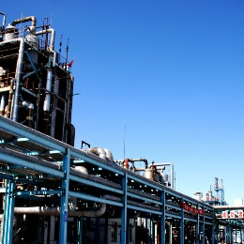

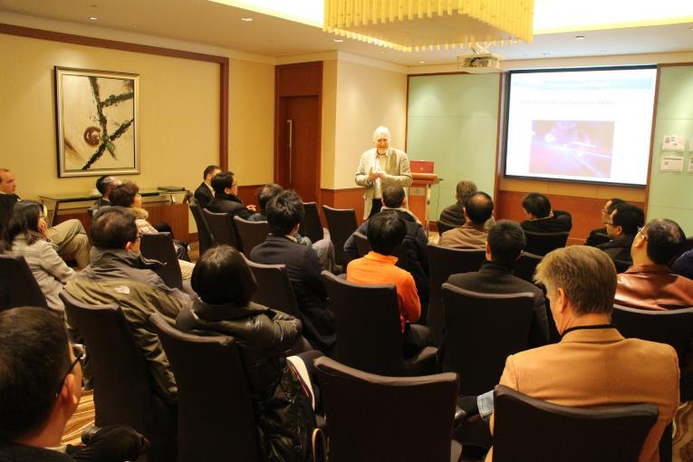
链接到
GenRay Consulting
GenRay Group Ltd. Co.
Home
About GenRay
GenRay Consulting
GenRay Innovation
Contact Us
链接到
About GenRay
链接到消费者测试咨询服务
GenRay
Values
Supplier
Consulting
Consumer
Research
GenRay
Innovation
GenRay
Products
GenRay
Activities
链接到
GenRay Innovation
暂无链接
链接到企业家聚会，家庭聚会

Slide 2




GenRay Group Ltd. Co.
Home
About GenRay
GenRay Consulting
GenRay Innovation
Contact Us
GenRay Values
Who we are?
Trust
Giving vs.
Taking
Where we are?
Fairness
Non-profitable activities
Cost
Effectiveness
Showing
Appreciation
Mutual
Respect

Slide 3











GenRay Group Ltd. Co.
Home
About GenRay
GenRay Consulting
GenRay Innovation
Contact Us
GenRay Values
Who we are?
Where we are?
Non-profitable activities
A very select group of executives and technical innovation experts from P&G, GE, Unilever, J&J, Heinz, Tesco... with successful track records, shared values, and recommended by trusted members.
The average working experience is more than 15 years, combined experience of 150+ years
Multi-skilled/Multicultural Group: Chinese, British, French and Singaporese.

Slide 4

GenRay Group Ltd. Co.
Home
About GenRay
GenRay Consulting
GenRay Innovation
Contact Us
GenRay Values
Who we are?
Where we are?
Non-profitable activities
UK
US
Shanghai
Hong Kong
Thailand
Singapore
Headquarters
UK and other Asian locations to be set up

Slide 5
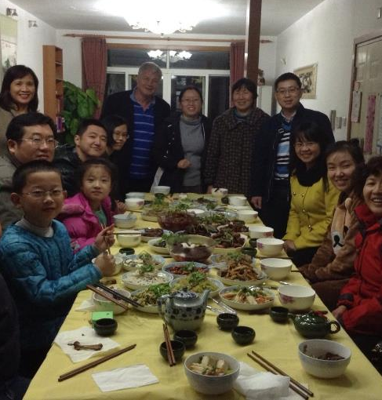
GenRay Group Ltd. Co.
Home
About GenRay
GenRay Consulting
GenRay Innovation
Contact Us
GenRay Values
Friend Circle - Entrepreneurs Forum
Friend Circle - Family Activities
Who we are?
Where we are?
Non-profitable activities
Family
Bring trusted friends and families together to create a set of common values.
Entrepreneur
Bring trusted entrepreneurial friends together, using our common values, to assist each other in being successful in business.

Slide 6
GenRay Group Ltd. Co.
Home
About GenRay
GenRay Consulting
GenRay Innovation
Contact Us
GenRay Consulting
R&D
Research
/ Test
Consumer
Marketing
Raw Material / Supplier Management
Consumer Marketing
Fully-Rounded
Total Technical
Solutions
Technical
Strategy /
Road
Map
Process
Management
General
Management
Soft
Skill

Slide 7
GenRay Group Ltd. Co.
Home
About GenRay
GenRay Consulting
GenRay Innovation
Contact Us
GenRay Consulting
1
New Raw Material
Qualification
For new products or
innovation
5
Supplier Change
Management
Ensure every change in Supplier
Is in control
Raw Material / Supplier Management
Consumer Marketing
2
Alternative Raw Material
Qualification
Supply continuation and cost
improvement
6
Supplier Process
Control Strategy
Process control at Supplier end
3
Quality Evaluation
How raw material impacts on
Product quality
7
Supplier Enabled Innovation
Supplier innovation to support
Innovation in customers’
Supplier Audit
On-site audit to understand the
Real condition and Supplier
Capability
Business Continuity Plan
Cooperate with Supplier to minimize
Risk in crisis
4
8

Slide 8



GenRay Group Ltd. Co.
Home
About GenRay
GenRay Consulting
GenRay Innovation
Contact Us
GenRay Consulting
Create targeted winning consumer sensory design and solutions
Stage I: QDA (quantitative descriptive analysis) provides sensory descriptions of products based on the perceptions of a group of trained panelists. The panel performs as a calibrated human instrument
Stage II: sensory road map via sensory workshop and unique sensory consumer research
Identify Core Sensory attribute Opportunity– partner with client team, 1-2 months
Sensory profiling/mapping and provide prototype design guidance – 4 months
Prototype qualification with unique analysis – 4 months
Stage III: Sensory technology map and direction for new technology development
Raw Material / Supplier Management
Consumer Marketing

Slide 9

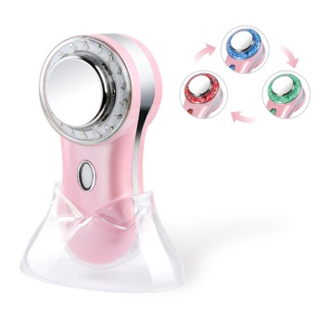





GenRay Group Ltd. Co.
Home
About GenRay
GenRay Consulting
GenRay Innovation
Contact Us
Skin Care
Skin Cleanser
Others
请将这些图片裁剪为大小一致。
链接至每个产品介绍，产品介绍参见Christina发的PPT，英文版

Slide 10

GenRay Group Ltd. Co.
Home
About GenRay
GenRay Consulting
GenRay Innovation
Contact Us
Skin Care
Skin Cleanser
Others
请添加产品介绍在旁边，产品介绍参见Christina发的PPT，英文版

Slide 11





GenRay Group Ltd. Co.
Home
About GenRay
GenRay Consulting
GenRay Innovation
Contact Us
Skin Care
Skin Cleanser
Others
请将这些图片裁剪为大小一致。
链接至每个产品介绍，产品介绍参见Christina发的PPT，英文版

